Slide 1
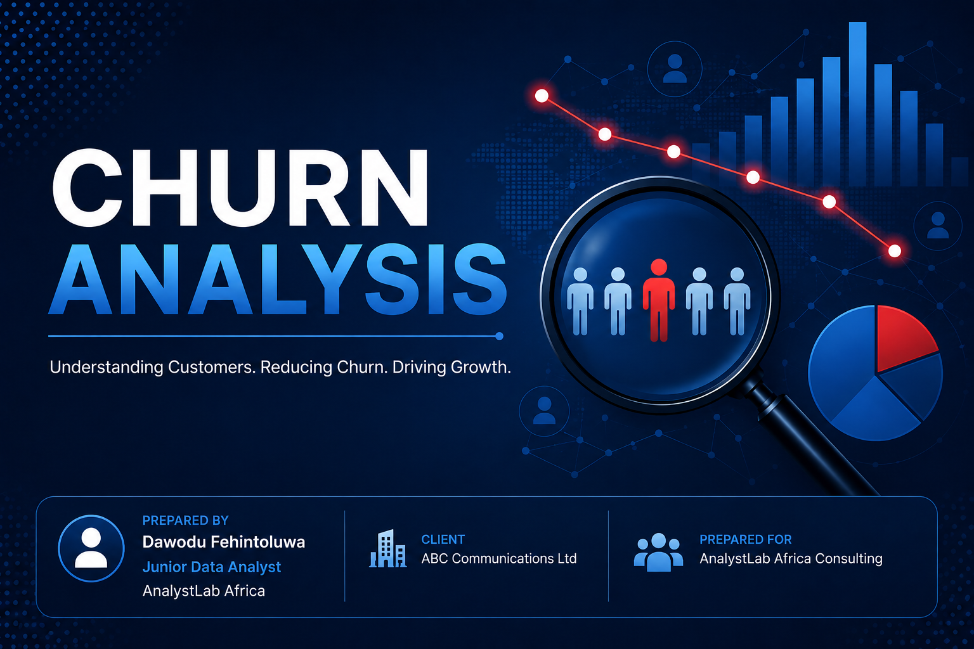
DAWODU FEHINTOLUWA

Slide 2
CHURN ANALYSIS
What is Customer Churn?
Customer churn is the percentage of customers who stop using a company's products or services within a specific period. This may include canceling subscriptions, switching to competitors, closing accounts, or simply discontinuing purchases.
Why Customer Churn Analysis Matters
Customer churn is important because it helps businesses measure customer satisfaction and identify areas needing improvement. High churn results in revenue loss, increased marketing costs to acquire new customers, reduced customer lifetime value, and slower business growth. Since retaining existing customers is generally more cost-effective than acquiring new ones, monitoring churn is essential for long-term profitability.
Factors Influencing Churn in Telecommunications
Customer churn in telecommunications is commonly influenced by:
Poor network coverage and slow internet speed
High call or data charges
Attractive competitor promotions
Poor customer service
Billing errors
Limited data plans
Frequent network outages
Lack of customer loyalty programs
Customer demographics and usage patterns
Payment history and subscription type

Slide 3
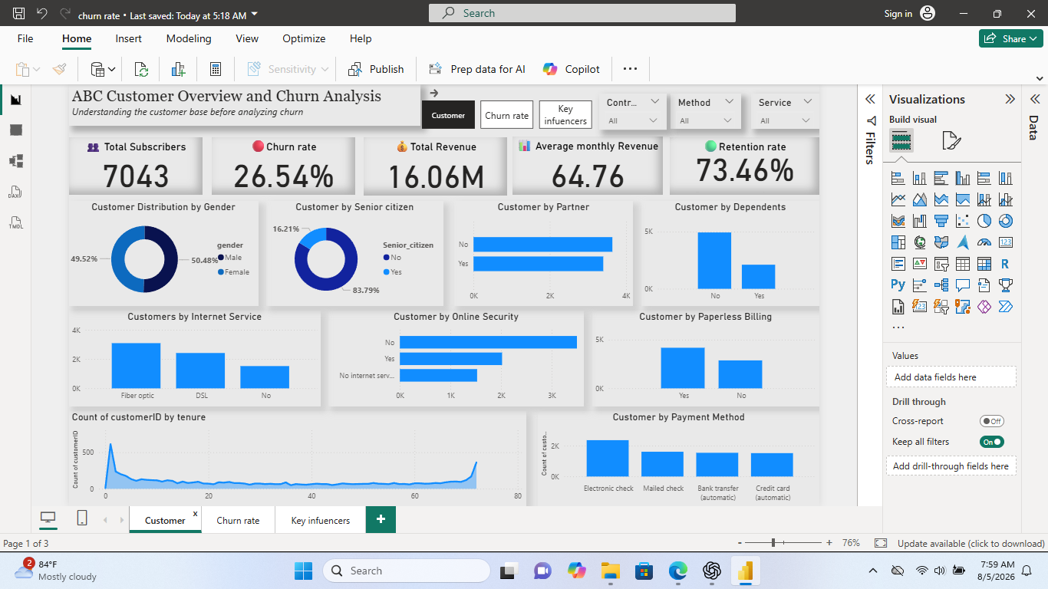
Customer Overview

Slide 4
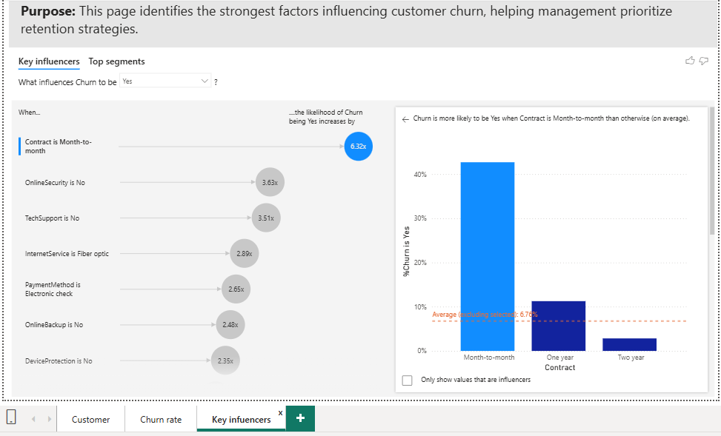
Key Drivers of Customer Churn Driver
Customers on month-to-month contract type are 6.32x likely to churn
Customers without Online Security or Tech Support are significantly more likely to churn.

Slide 5
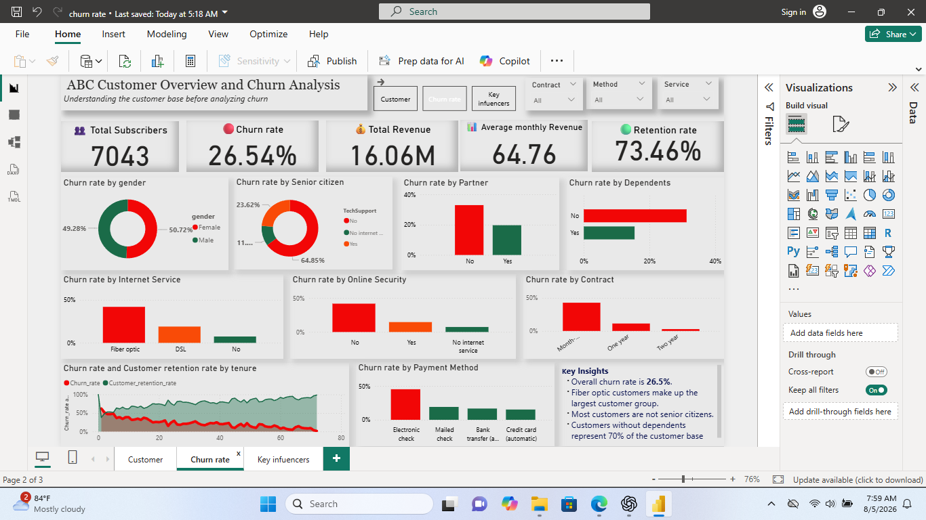
Churn Analysis

Slide 6
Key Insights
Customers on month-to-month contracts experience the highest churn rate and are 6.32 times more likely to leave than customers on longer-term contracts.
Customers without Online Security, Tech Support, or Device Protection services also show significantly higher churn.
Customers using fiber optic internet and those who pay through electronic checks exhibit higher churn rates than other customer groups.
There is a strong relationship between customer tenure and retention. Customers who have remained with the company for longer periods are less likely to churn.
Customers who use Electronic Check as their payment method have the highest churn rate compared to customers using automatic bank transfers, credit cards, or mailed checks.

Slide 7
Business Risks & Opportunities
Business Risks
High revenue leakage from customer attrition.
Increased customer acquisition costs.
Reduced customer lifetime value.
Business Opportunities
Increase long-term contract adoption.
Bundle premium services.
Implement predictive churn monitoring.

Slide 8
Recommendations
1. Encourage Customers to Subscribe to Long-Term Contracts
Introduce attractive discounts, loyalty rewards, or exclusive benefits for customers who migrate from month-to-month subscriptions to one-year or two-year contracts. This strategy will improve customer retention and provide more predictable revenue.
2. Strengthen Technical Support Services
Invest in responsive, high-quality technical support to resolve customer issues quickly. Providing 24/7 support, faster issue resolution, and proactive customer assistance will improve customer satisfaction and reduce churn.
3. Improve Payment Experience
Encourage customers using Electronic Check to switch to automatic payment methods such as bank transfers or credit card payments. Offering incentives for automatic payments can improve convenience and reduce churn associated with billing issues.
4. Promote Online Security Services
Educate customers on the benefits of Online Security. Customers who use Online Security services are less likely to leave because they perceive greater value from the company's offerings.
5. Review Fiber Optic Customer Experience
Although Fiber Optic is the most popular internet service, it is also associated with higher churn. Management should investigate customer complaints, assess service quality, network reliability, pricing, and customer support for Fiber Optic users.
6. Develop Early Customer Retention Programs
Since customers with shorter tenure are more likely to churn, implement onboarding programs, regular follow-up communication, and personalized offers during the first 12 months of the customer relationship. Early engagement can significantly improve long-term customer loyalty

Slide 9
Conclusion
Customer churn is primarily driven by contract type, value-added services, payment method, and customer tenure. By encouraging long-term contracts, improving service quality, and implementing targeted retention strategies, ABC Communications can significantly reduce churn and improve profitability.

